Slide 1
The Syllabus
Kate Browne & Carmela Ferradáns
nonorg presentation 1.11.2016

Slide 2
today’s nonorg
The Syllabus: Part I
The purposes of the syllabus
Sample syllabi
Information you should include in your syllabus
A syllabus template for IWU
The syllabus as a reading & writing assignment
The Syllabus: Part II
info, graphics and info-graphics

Slide 3
The Syllabus: Part One
purposes, uses and samples

Slide 4
syllabus (n)
1650s, "table of contents of a series of lectures, etc.," from Late Latin syllabus "list," ultimately a misreading of Greek sittybos "parchment label, table of contents," of unknown origin. The misprint appeared in a 15c. edition of Cicero's "Ad Atticum" (see OED). Had it been a real word, the proper plural would be syllabi.
http://www.etymonline.com/index.php?term=syllabus

Slide 5
The purposes of the syllabus
“A syllabus has several functions. The first function is to invite students to your course--to inform them of the objectives of the course and to provide a sense of what the course will be like. The second function is to provide a kind of contract between instructors and students – to document expectations for assignments and grade allocations. The third function is to provide a guiding reference – a resource to which students and instructional staff can refer for logistical information such as the schedule for the course and office hours, as well as rationale for the pedagogy and course content.” http://bokcenter.harvard.edu/syllabus-design 1. to invite students to your course (course description, learning objectives, description of assignments) 2. to provide a contract between students and instructor (expectations for assignments and grading) 3. to provide a guiding reference (schedule, office hours, due dates, and teaching philosophy)
Other resources Teaching at its Best by Linda B. Nilson, 2010. Chapter 3: The Complete Syllabus (33-41) Engaging Ideas by John C. Bean, 2011 “Death to the Syllabus” by Mano Singhan, 2007 https://www.aacu.org/publications-research/periodicals/death-syllabus “It is time to declare war on the traditional course syllabus. If there is one single artifact that pinpoints the degradation of liberal education, it is the rule-infested, punitive, controlling syllabus that is handed out to students on the first day of class.”

Slide 6
Sample Syllabi
The Traditional Print-oriented Syllabus https://www.iwu.edu/melloncenter/rubrics-and-syllabi.html
The Digital Syllabus Prof. Erin McLaughlin Multimedia and Rhetoric https://magic.piktochart.com/output/2570368-syllabus-wr-13300#.VdZYZXQw6FR.gmail
The Graphic Syllabus The Graphic Syllabus and the Outcomes Map: Communicating your Course by Linda Nilson 2007. Nilson’s argument: when key information about a course, such as its structure, content, and assignments, is presented through graphics, it will be more easily understood and retained by students. http://azargrammar.com/teacherTalk/blog/2010/01/using-graphic-syllabi-in-your-classroom/

Slide 7
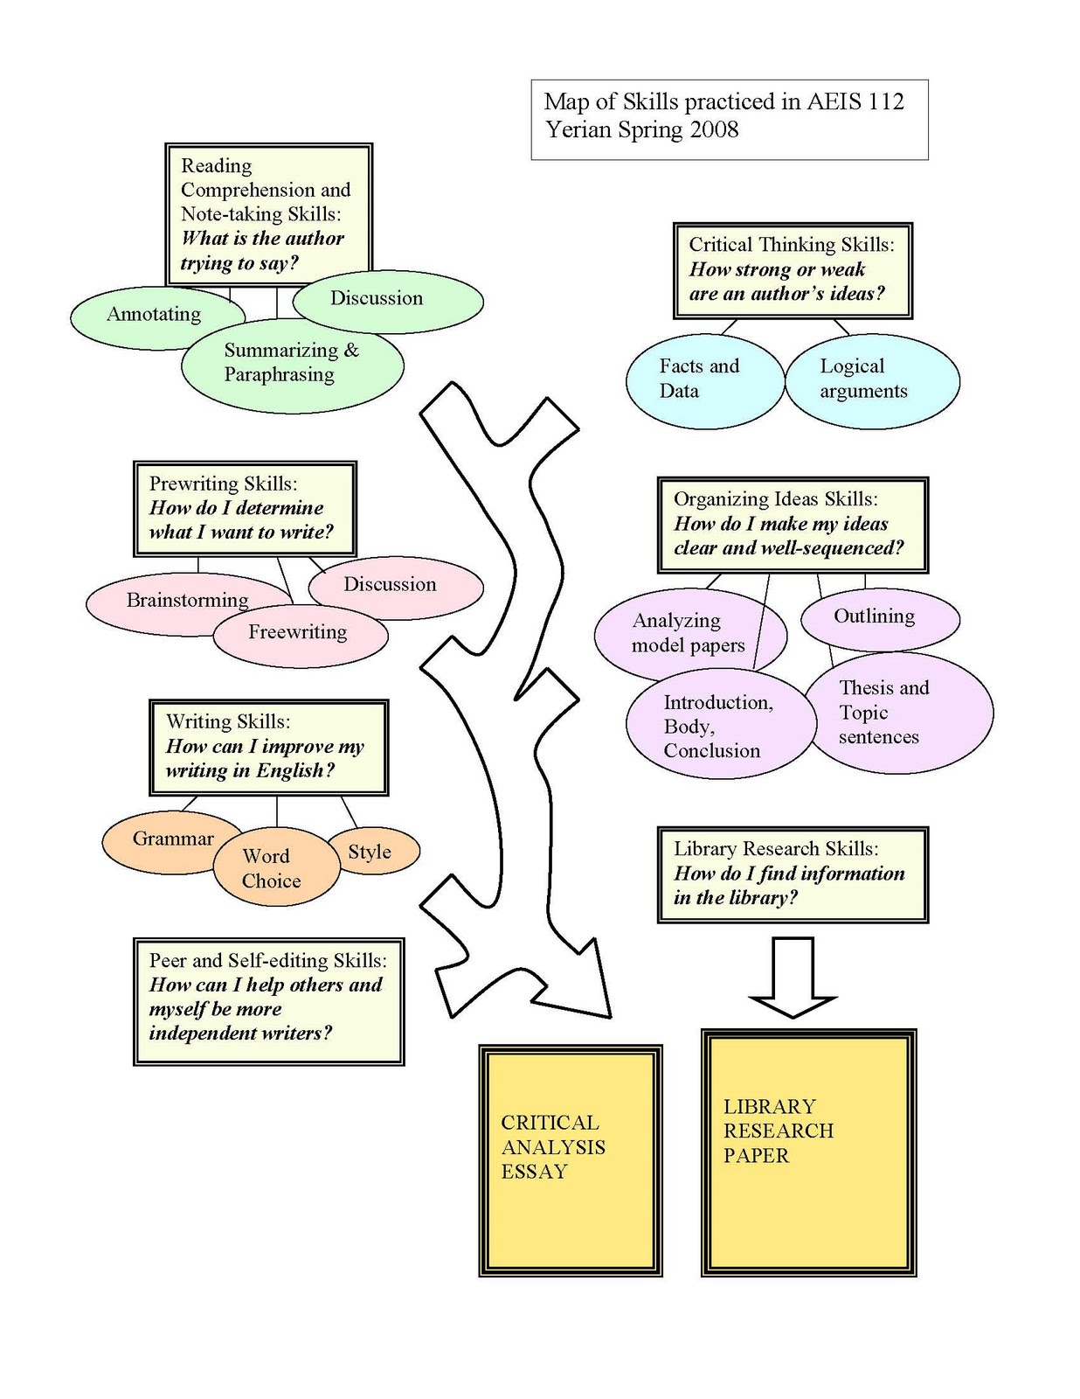
sample graphic syllabus 1 http://azargrammar.com/teacherTalk/blog/2010/01/using-graphic-syllabi-in-your-classroom/

Slide 8
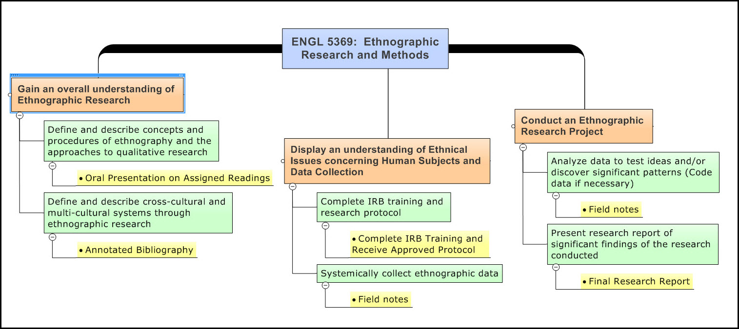
sample graphic syllabus 2 http://chronicle.com/blogs/profhacker/graphic-display-of-student-learning-objectives/27863

Slide 9
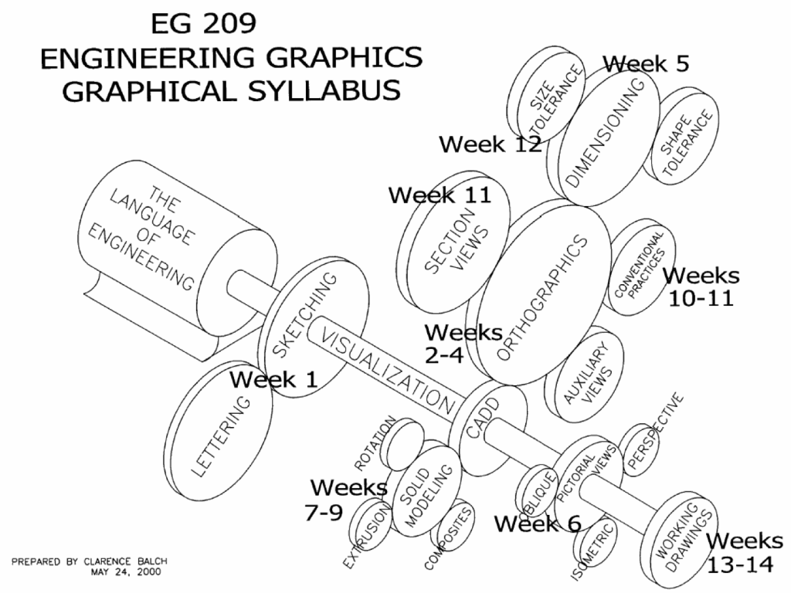
sample graphic syllabus 3 http://blogs.agu.org/geoedtrek/2014/08/06/graphic-syllabus/

Slide 10
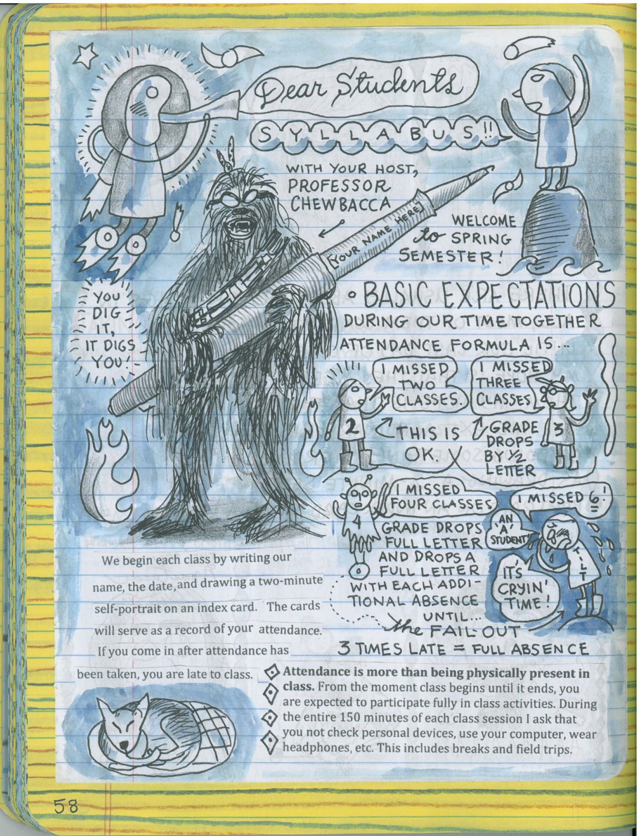
sample graphic syllabus 4
Prof. Lynda Barry

Slide 11
What to include in your syllabus http://bokcenter.harvard.edu/syllabus-design
Learning Objectives: What students will gain or take away from your course. Why these objectives are the most important skills/knowledge for the course (helpful if objectives are included for each topic/session).
Goal/Rationale: How the course relates to primary concepts and principles of the discipline (where it fits into the overall intellectual area). Type of knowledge and abilities that will be emphasized. How and why the course is organized in a particular sequence.
Basic Information: Course name and number, meeting time and place, instructor name, contact information, office hours, instructional support staff information.
Course Content: Schedule, outline, meeting dates and holidays, major topics and sub-topics preferably with rationale for inclusion.
Student Responsibilities: Particulars and rationale for homework, projects, quizzes, exams, reading requirements, participation, due dates, etc. Policies on lateness, missed work, extra credit, etc.
Grading Method: Clear, explicit statement of assessment process and measurements.
Materials and Access: Required texts and readings, course packs. How to get materials including relevant instructional technologies. Additional resources such as study groups, etc.
Teaching Philosophy: Pedagogical approach including rationale for why students will benefit from it.

Slide 12
Information you should include in your syllabus
IWU Faculty Responsibilities, Resources and Related Policies (Faculty Handbook, Chapter V)
"Each faculty member is required to produce and distribute, preferably at the first class meeting, but in any event within the first week of classes, a written syllabus explaining the aims, scope and format of the course, readings and other class experiences, such as class discussions, panels, quizzes, papers, and examinations. The syllabus must also include class attendance policy, grading policy, and office hours. Written course outlines, where appropriate, are strongly encouraged." (Faculty Handbook, Chapter V-9, 3.Course Syllabi)
aims scope and format readings class experiences attendance policy grading policy office hours

Slide 13
2015-16 Course Catalog The Academic Program (64-67)
Class attendance
“Attendance policies are established by individual faculty members for each class and therefore may vary from course to course. Students may expect the course attendance policy to be stated in the syllabus for that course. However, in general, students are expected to attend classes regularly.” 64-65
Final examinations
“Comprehensive final examinations are not a mandatory part of every course, but a final exam or other activity must be administered during the scheduled final examination period.” 65
Grade designations and quality points “Credit at Illinois Wesleyan University is awarded on the basis of criteria of subject mastery or competence. The University does not use a uniform range of percentage scores in determining letter grades, nor does it award a predetermined percentage of letter grades in the various grade categories.”
“Student academic performance is evaluated according to the following system of grade and quality point designations: Only letter grades count toward the GPA,
A, A- Credit for work of superior quality.
B+, B, B- Credit for work of good to very good quality.
C+, C Credit for work of acceptable but not distinguished quality.
C- Credit for work of marginal quality.
D Credit for work of poor quality.
F Failure” (65-66)

Slide 14
a syllabus template for IWU courses
Basic Information: Course name and number, meeting time and place, instructor name, contact information, office hours.
Course Description.
Course Learning Goals.
Materials and Access.
Grading Method and Grading Scale.
Class Attendance Policy.
Course Policy.
A tentative daily/weekly schedule with dates for major projects, exams and quizzes.
For IWU syllabi templates, please see the Mellon Center Web page https://www.iwu.edu/melloncenter/rubrics-and-syllabi.html

Slide 15
reading & writing assignments based on your syllabi
1.-In-class activities for the first day of class. Go over the syllabus yourself, then allow some time for the students to read it. Break the class into small groups to do one of the following activities: (Nilson, 40)
a. discuss the document and answer each-other’s questions about it; b. make a list of questions they should never ask you because the answer is on the syllabus; c. send the students on a scavenger hunt for critical information.
2.-Assign it as homework, answer questions about it the second day of class and have the students sign a contract with statements like this “ I have read the course syllabus and understand its contents.” (Nilson, 40)
3.-Assign it as homework and give a graded test on it on the second day of class (Nilson, 40)

Slide 16
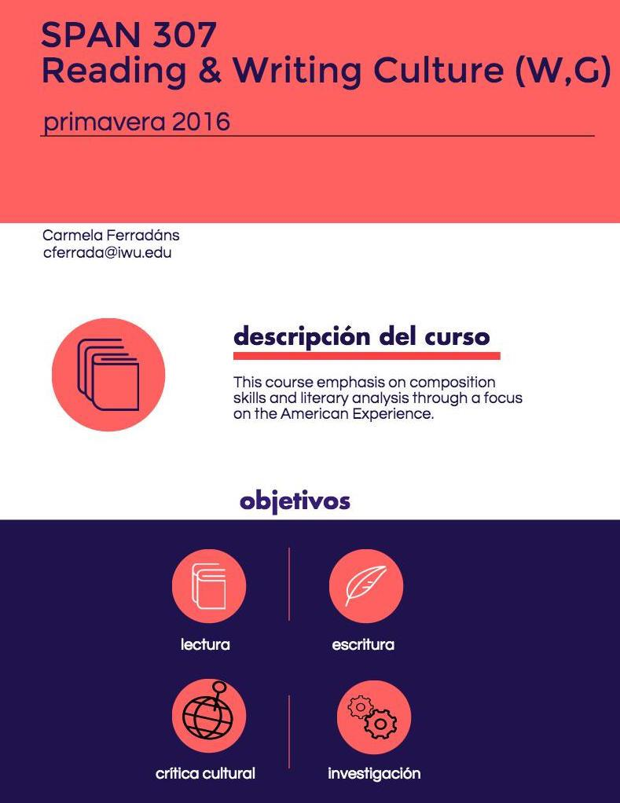
SPAN 307 Reading & Writing Culture (W,G)
spring 206
Prof. Carmela Ferradáns cferrada@iwu.edu 556-3155
Office: BUCK 206 & CLA 328, cferrada@iwu.edu
Office Hours: M 11-noon, M&W 3:15-4:00PM in Buck 206; TTH 2:30-4:00 in CLA 328
"Culture" is one of the most searched words in the web, and has different meanings depending on context. What do we mean when we say "latin@, Caribbean, Spanish or Latin American cultures"? What are the social and political nuances of the word "culture" in these contexts? In this assignment-based course, we will explore a variety of research strategies pertaining to the study of these cultures, and analyze, compare and contrast different cultural practices and discourses in Spanish, Latin American, and US Latin@ & Caribbean societies.
Busca SPA 307 en Moodle http://courses.iwu.edu
Span 307 first paragraphs of the “analog syllabus”
Span 307: An attempt for a “digital” syllabus

Slide 17
The Syllabus: Part Two
Info, graphics, and infographics

Slide 18
Case Study: Gateway Fall 2015
Link to sample syllabus
Benefits of using a digital, cloud-based syllabus
Always available for students
Saves paper (cliche, but true!)
Students can modify according to their needs
download or print
font size/style, font color, highlight
personal annotations
Grounding Theory: When students have control over the medium, they take responsibility for the content

Slide 19
Case Study: Gateway Fall 2015
If I had to do it all again…
add more graphics or interactivity! A boring syllabus in the cloud is a boring syllabus on paper
teach first-year students what a syllabus is and how to use it
develop an activity that asks students to engage with content and form as a skill-based exercise

Slide 20
Technologies to Create Syllabi
Analog
Pen(cil) and paper
Typewriter
Art tools (paint, crayons, markers, chalk, etc.)
Digital
word processing software (Word, Notepad, Google Docs)
mapping/presentation software (MindMeister, PowerPoint, Prezi)
drawing software (Photoshop, MS Paint, Piktochart, tablet & pen)
Link to Piktochart experiment
Or experiment with mixed media!

Slide 21
Things to Consider
Do you want to learn a new technology? If so, how much time do you want to spend learning?
How do your biases influence “appropriate” use of technology?
How will different media integrate with other elements for your course? Example: how well does a Piktochart integrate into Moodle? (spoiler alert: not well)
Can students access your syllabus in multiple ways?
How accessible is your syllabus?
How do you want students to interact and engage with your syllabus?

