Slide 1
ALPHA PHI OMEGA
SPRIng Semester 2012
Notes:
apo@lists.iwu.edu, link for apo database

Slide 2
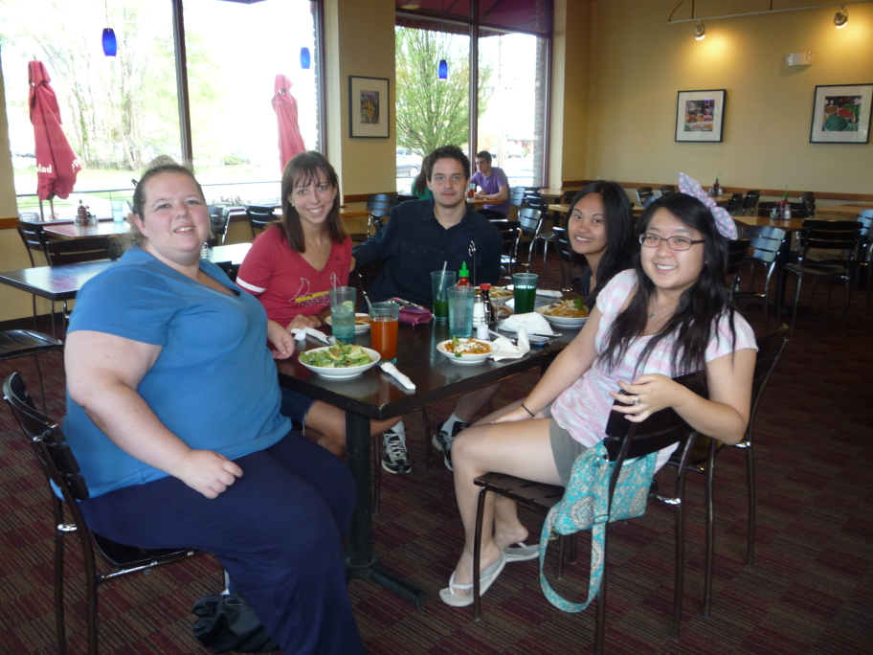
VP Community: Michelle Moon email: apo.oe.community@gmail.com

Slide 3
VP Membership: Katherine Henning email: apo.oe.membership@gmail.com
Your hours should be in by tomorrow! Many of you are still on bad standing!!!
-If you are on bad standing, you don't get a sequin. If you want your sequin, email me hours and then come and find me before Sunday.
-Birthdays:
Megan Dyer: April 18th
Emma Craig: April 19th
Maddie Cross: April 23rd
Vicki Simmons: May 17th
Mike Goldstein: May 18th
Alyssa Shannon: May 19th
Lindsay Bow: May 29th
Kristy Lazicki: June 6th
Onyinye Udenze: June 10th
Sam Krueger: June 13th
Anne Fritsch: June 22nd
Sarah Bergman: June 27th
Rebeca Cruz: July 1st
Ben Gesensway: July 12th
Hayley Harroun: July 13th
Kim Cheffer: July 19th
Carly Wilson: July 21st
Izzy Moon: August 15th
Kelsey Koterla: August 17th
Elise Haury: August 17th
Lesley Ramirez: August 24th

Slide 4
Meet Your Brothers
Marissa Deweese
Is a math and physics major
Plays the flute
Favorite animal is a baby sloth
Ben Gesensway
Has been on a 50-day canoe trip in Canada
Likes the tv show Bones

Slide 5
Meet Your Brothers
Stephanie Rosenbaugh
Enjoys playing video games, especially Zelda
Like pumpkins
Elise Haury
Broke both of her wrists simultaneously via a scooter accident less than 24 hrs before her family’s vacation to Hawaii

Slide 6
Meet Your Brothers
Emily Oprins
Lived in Luxembourg for about 3 years
Has extremely freaky-neat handwriting

Slide 7
Appointed Positions:
Alumni Chair –
Chaplain –
Historian –
Student Senate Liason-

Slide 8
Old Business

Slide 9
New Business

Slide 10
News or Announcements

Slide 11
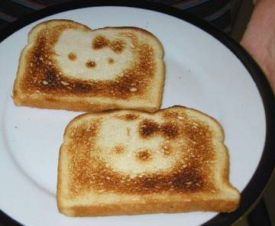
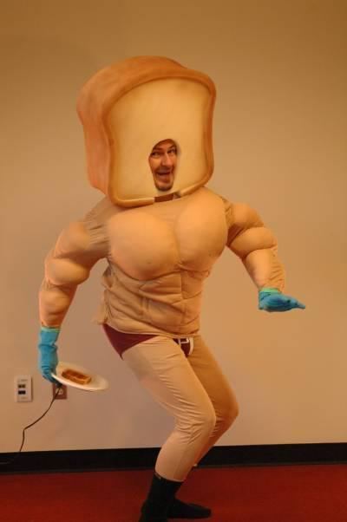
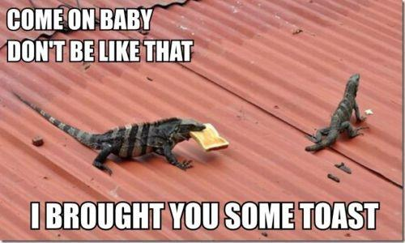
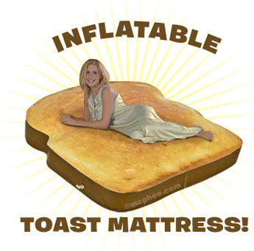
TOAST SONG!!

