Slide 1
ALPHA PHI OMEGA
SPRIng Semester 2012
Notes:
apo@lists.iwu.edu, link for apo database

Slide 2
President: Carly Wilson email: apo.oe.president@gmail.com
Nominations tonight and next week
Initiation – April 3, 9 PM Davidson Room
Elections – April 10, 9 PM, Beckman Auditorium (Ames Library)
Last meeting/Changeover/Senior Recognition – April 17
Come to Exec Board for ONE leadership point – Sundays, 9PM, CNS Atrium

Slide 3
VP Community: Michelle Moon email: apo.oe.community@gmail.com
Spring Carnival at Stevenson Elementary School - Saturday, April 14
The volunteers will be running games, helping with refreshments, helping with line control for the Zoo Lady, and helping sell tickets.
Children's Home + Aid 5K - Sunday, April 15
Tipton Park: 2410 G.E. Road, Bloomington, IL
Register onhttp://volunteertoendchildabuse-esearch.eventbrite.com/?srnk=3
to possibly receive a free t-shirt
In memory of Duncan & Jack Leichtenberg who were victims of domestic violence. To raise awareness to end child abuse and raise money for the Family Visitation Center at Children's Home + Aid
10 people - directing runners where to go on the course - 1:45-4pm
4-8 people - help with children's activities - little before 1pm-2pm

Slide 4
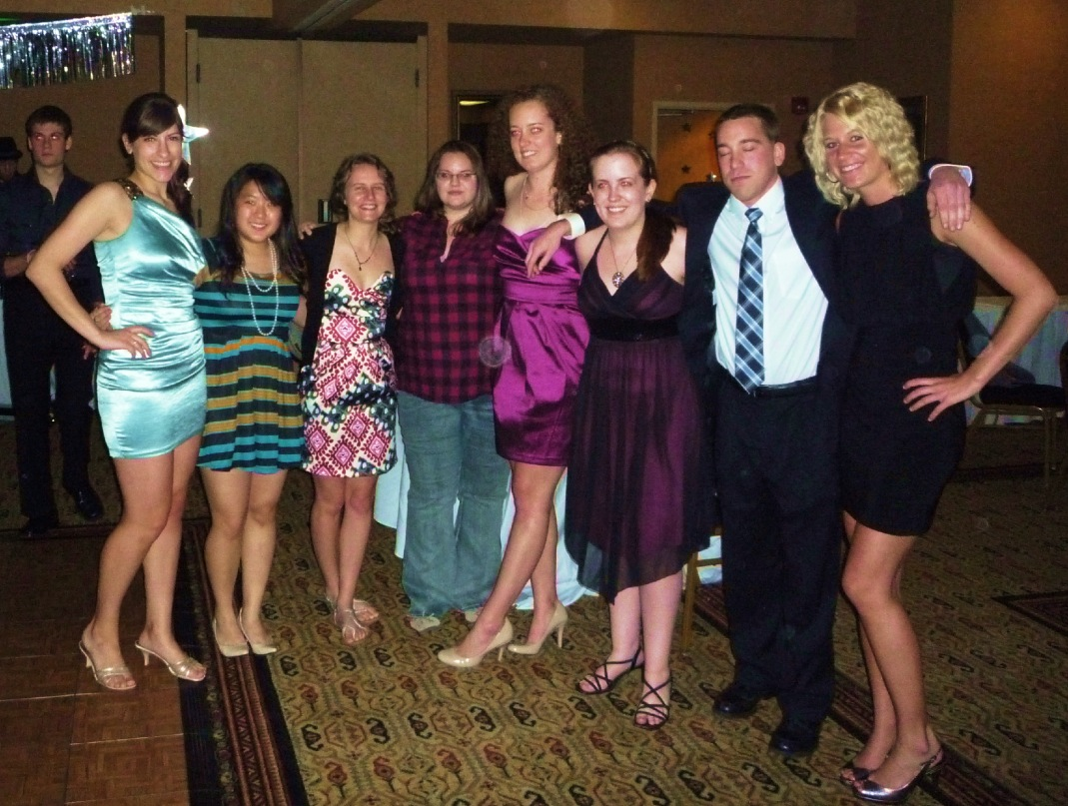
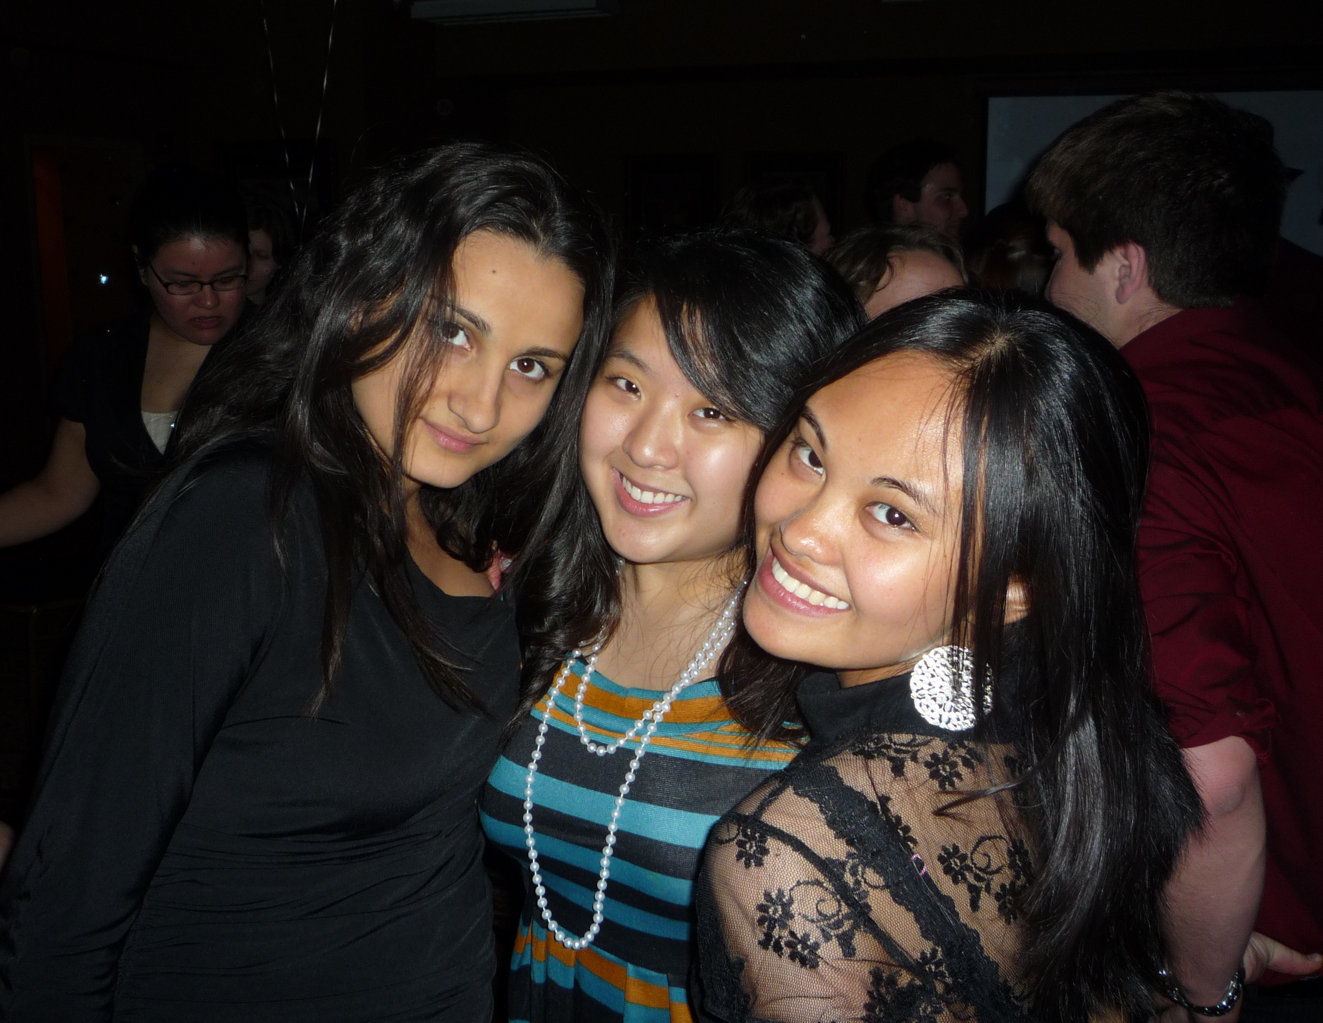
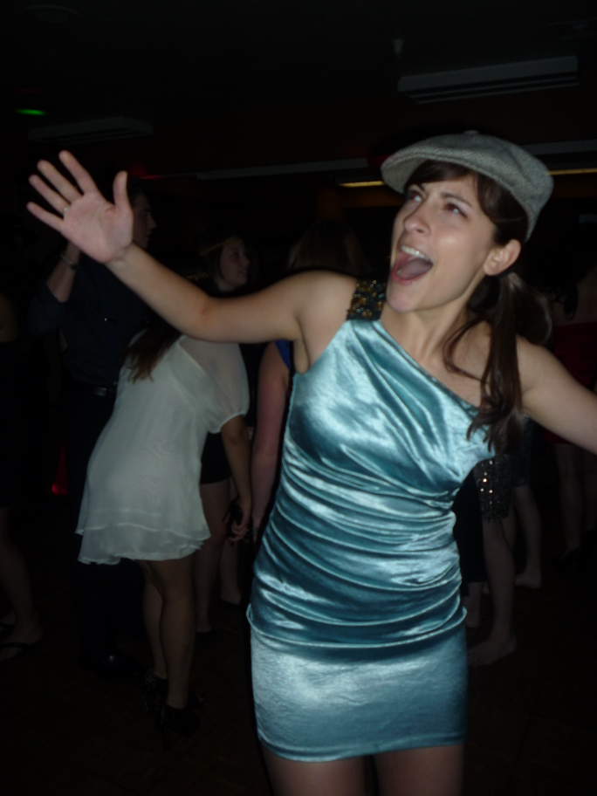
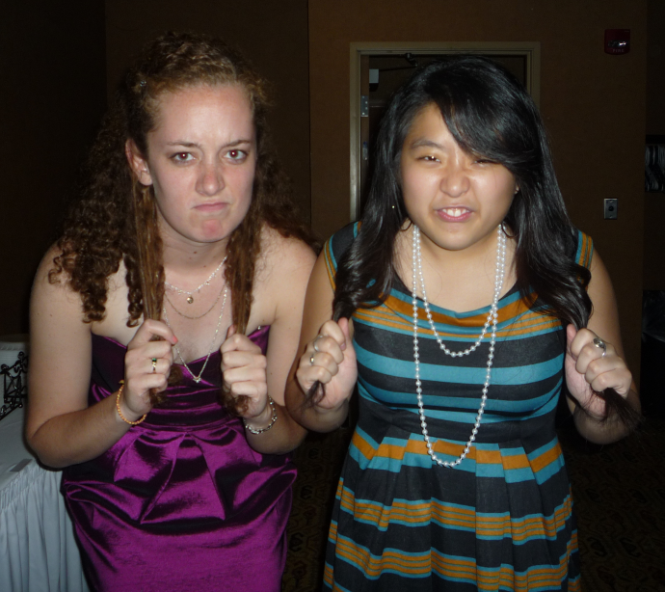

Slide 5
VP Campus, National & Frat.: Ronnie Watson email: apo.oe.cnf@gmail.com
Possible Food Pantry - Monday April 2nd - needed?
Boys and Girls Club orientation - Tuesday April 3rd 4:30
Habitat Restore - Wed, Thurs, Fri, next week
Quilt Show - Thursday April 12th
Wellness Expo - Saturday April 14th
PLEASE TALK TO ME IF YOU HAVE TROUBLE WITH HOURS!!!!!!!!!!!

Slide 6
VP Fellowship: Vicki Simmons email: apo.oe.fellowship@gmail.com
Dinner at FlatTop: Thursday, 3/29 at 6
Edible Book Festival at ISU: Monday, 4/2 at noon
Passover Seder: Wednesday, 4/11 at 6:30
Ice cream at Coldstone: Thursday, 4/12 at 7:30
Undercover XX: Friday, 4/13 at 8

Slide 7
Treasurer: Ben Gesensway email: apo.oe.treasurer@gmail.com
Pizza on the Quad
This Saturday
11pm - 1 am
Car Wash
April 14
11am - 5pm
Kroger parking lot
2 shifts

Slide 8
Pledge Educator: Liz Kuehn email: apo.oe.pledge@gmail.com
Pledge meetings are held in CNS C102 at 8:15pm on Tuesdays and actives need to come to at least one meeting. There is only one meeting left!!
Pledges send in your hours to Tim by Sunday 4/1 (service, fellowship, and leadership points)-- tborchar@iwu.edu
Pledges and Pledge Parents - Fellowship tomorrow 3/28
Initiation 4/1 and 4/3- Davidson Room

Slide 9
Meet The Pledges
Michelle Brand
She was an Illinois Ambassador of Music and toured 7 countries in Europe
Favorite TV show: Glee
Favorite Animal: Panda
Lauren Streblo
She went to an all-girls high school and had to wear a kilt
Favorite service events involve anything to do with kids
Favorite snack: Ice cream

Slide 10
Meet The Pledges
Hilary Charlet
She lives on a dairy farm and her dad milks cows
Favorite colors: Lime green and purple
She also like Pilates, running, and being with friends

Slide 11
VP Membership: Katherine Henning email: apo.oe.membership@gmail.com
-Seniors, you need to be on good standing to get your cords -Send me hours -Come to the Fellowship Thursday night to help put together study abroad care packages.
Birthdays: Emily Oprins – March 21st Emily Schmidt – March 25th

Slide 12
Meet Your Brothers
Tim Borchardt
Is a huge New England Patriots fan
Enjoys creative writing
Merlin is his favorite show ever
Brianna Yarwood
Has been in 4 states at once
Likes the show Gilmore Girls
Likes the movie Grease

Slide 13
Meet Your Brothers
Katelyn Fink
Has never been in a hospital
Enjoys singing
Lindsay Bow
Cannot burp
Enjoys rock climbing and sailing

Slide 14
Meet Your Brothers
Alyssa Payleitner
Has had the chicken pox 5 times
Favorite animal: Sea turtle
Onyinye Udenze
Has a 2 year old brother
Enjoys cooking

Slide 15
Meet Your Brothers
Katie Cannon
Studied abroad in the UK
Enjoys cooking and baking
Michelle Moon
Got thrown down a hill by a bull in Korea
Enjoys playing guitar and, ironically, watching the Bulls

Slide 16
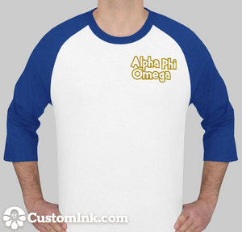
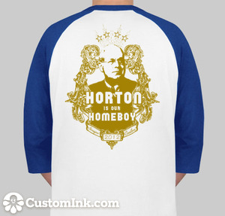
VP Communications: Lindsay Bow email: apo.oe.communications@gmail.com
T-shirts are $17.66 each

Slide 17
Sergeant-at-Arms: Jason Murphy email: apo.oe.sergeant@gmail.com
Section 3.5: Active Membership.
An Active Member shall:
be a student of Illinois Wesleyan University;
have completed a period of pledge-ship including participation in the Initiation Ceremony;
have paid all dues and fees specified by a two-thirds (2/3) vote of the members whom otherwise fill these requirements;
have fulfilled a service requirement--this shall be twenty (20) hours in all four fields of service, with three of the hours being fundraising hours completed with the purpose of raising funds specifically for the Omega Epsilon chapter of Alpha Phi Omega. No less than one hour will be accepted to fill each field. In the event that an adequate amount of service hours are not offered, then the total required number of hours an active must fulfill will be two-thirds (2/3) of the total offered hours;

Slide 18
Appointed Positions:
Student Senate Liaison - Sarah Bergman
Chaplain - Daniel Maurer
Historian - Kaitlyn Eichinger
Alumni Chair - Tiara Thomas
Webmaster - Thomas Simmons
Leadership Chair - Hayley Harroun
Section 50 Service Project Chair – Emily Schmidt

Slide 19
Old Business

Slide 20
New Business
Nominations

Slide 21
President
The President shall:
A. call and reside over all meetings of the active body and the executive board;
B. see that the duties and obligations of the fraternity are met;
C. enforce all regulating rules and guidelines as stated in Article 11 Section 2.1 in a manner consistent with the spirit of Alpha Phi Omega;
D. appoint necessary positions at the beginning of the semester based off of the current needs of the chapter and approval of the chapter
E. try his/her best to ensure that the duties of all officers are met either by acting him/herself or by appointing an active to temporarily fulfill the duties of the absent officer;
F. advise and assist all officers in the performance of their duties as necessary and to the best of his/her ability;
G. exercise one-vote at all sectional, regional, and national conventions or appoint a replacement to fulfill this duty.
H. represent the chapter at all sectional, regional, and national conferences, or find a replacement for this duty;
I. give a written report and inform the chapter of all sectional, regional, and national activities which pertain to the chapter.

Slide 22
Vice-President of Community Service
The Vice President of Community Service shall:
A. arrange and promote all community based service projects for the active body and shall encourage members to attend;
B. appoint an Assistant Service Chairman and any other members necessary to assist in their responsibilities as needed -- this committee shall be called the Community Service Committee, within which the Vice-President of Service shall chair;
C. act for the President in their responsibilities as needed;
D. maintain a summary of all chapter projects and project contacts;
E. present a project proposal for each activity to the Executive Board for any necessary discussion,
F. provide or organize at least two (2) service projects a month and keep track of the total service hours they make available throughout the semester.

Slide 23
Vice-President of Fraternity, Campus, and National Service
The Vice-President of FCN Service shall:
A. arrange and promote all fraternity, campus or national based service projects for the active body and shall encourage members to attend;
B. appoint an Assistant Service Chairman and any other members necessary to assist in their responsibilities as needed -- this committee shall be called the FCN Service Committee, within which the Vice-President of Service shall chair;
C. maintain a summary of all chapter projects and project contacts;
D. present a project proposal for each activity to the Executive Board for any necessary discussion,
E. provide or organize at least two (2) service projects a month and keep track of the total service hours they make available throughout the semester.

Slide 24
Vice-President of Membership
The Vice-President of Membership shall:
A. appoint an Assistant Membership Chairman, and any other members necessary to assist in their responsibilities -- this committee shall be called the Membership Committee and within which, the Vice-President of Membership shall chair;
B. be responsible for keeping an account of service project and business meeting attendance for the purpose of determining active voting rights/ as well as up-to-date calling lists of all actives and pledges;
C. present a proposed program of active membership retention as needed;
D. notify all Members in Bad Standing and Inactive Members of their violations.

Slide 25
Vice-President of Pledge Education
The Vice-President of Pledge Education shall:
A. obtain a meeting place for pledge meetings;
B. submit a pledge program for approval by a two-thirds (2/3) vote at the beginning of each semester, and define activities eligible for the pledge service requirement, upon approval by a two-thirds (2/3) vote;
C. supervise the pledge program throughout the semester;
D. organize initiation and activation ceremonies;
E. encourage and inform the active members to perform their responsibilities concerning pledges;
F. regularly inform the chapter of the progress of the pledge program;
G. appoint an assistant pledge educator;
H. assign pledge parents to all pledges with the help and consultation of the Membership Committee;
I. be responsible for keeping and maintaining pledging materials, including pledge pins, and being responsible for collecting the appropriate fees if the pledge pins are not returned at the end of the pledge period.
J. organize an effective rush program at the beginning of each semester in conjunction with the Vice President of Membership.

Slide 26
Vice-President of Fellowship
The Vice President of Fellowship shall:
A. plan and coordinate all chapter social activities with the assistance of the Fellowship Committee, from within which the Vice President of Fellowship Activities shall chair;
B. consult the chapter and appropriate funds before any activities if necessary; organize at least two (2) socials per month as well as organize an annual Spring Formal

Slide 27
Secretary
The Secretary shall:
A. maintain an up-to-date minutes book, containing the minutes of all active business meetings and executive board meetings, copies of received and sent correspondence, and current Torch and Trefoils;
B. hold correspondence when requested by the chapter;
C. obtain a meeting place at some convenient location for the actives meetings;
D. if necessary, appoint an Assistant Correspondence Secretary to assist in their responsibilities;
E. be responsible for distribution of minutes to actives and advisors;
F. be responsible for correspondence, written and spoken, to keep Advisory Committee up-to-date on chapter happenings.

Slide 28
Sergeant-at-Arms
The Sergeant-at-Arms shall:
A. guard the door against nonmembers at special meetings;
B. carry out all disciplinary and parliamentary procedures deemed necessary by the chapter or presiding officer;
C. diligently consider all parliamentary questions and advise the President and chapter on any such questions;
D. supervise chapter elections or appoint some member to supervise the election in the event that he/she cannot;
E. inform each officer and the chapter of their constitutional responsibilities at the beginning of each semester;
F. be responsible for keeping and maintaining all ritual materials; if necessary, form and chair the by-law Committee to discuss and make appropriate changes to the by-laws.
G. be the primary writer of the chapter supplement pledge manual.

Slide 29
Treasurer
The Treasurer shall:
A. collect all dues and fees from chapter members and keep a record thereof;
B. transmit all fees and any accompanying necessary forms to the national office;
C. promptly pay all authorized bills incurred by the chapter and promptly make all other authorized payments;
D. work in accordance with the regulations of Illinois Wesleyan University;
E. be responsible for a monthly financial report to the active body on the condition of the chapter
F. apply for nonprofit organization status with the Internal Revenue Service at the beginning of each calendar year;

Slide 30
Vice-President of Leadership
The Vice President of Leadership shall:
A. arrange and promote all leadership activities for the active body and shall encourage members to attend
B. appoint an Assistant Leadership Chairman and any other members necessary to assist in their responsibilities as needed -- this committee shall be called the Leadership Committee, within which the Vice President of Leadership shall chair
C. maintain a summary of all leadership activities and contacts
D. present a project proposal for each activity to the Executive Board for any necessary discussion
E. provide or organize at least two (2) leadership activities a month and keep track of the total points made available throughout the semester

Slide 31
Fundraising Chair
The Fundraising Chair shall:
A. arrange and promote all fundraising activities for the active body and shall encourage members to attend
B. appoint an Assistant Fundraising Chairman and any other members necessary to assist in their responsibilities as needed – this committee shall be called the Fundraising Committee, within which the Fundraising Chair shall chair
C. maintain a summary of all fundraising activities and contacts
D. present a project proposal for each activity to the Executive Board for any necessary discussion
E. provide or organize at least (2) fundraising activities a month, raising at least $500 per semester, and keep track of the total hours and funds raised throughout the semester.

Slide 32
News or Announcements

Slide 33
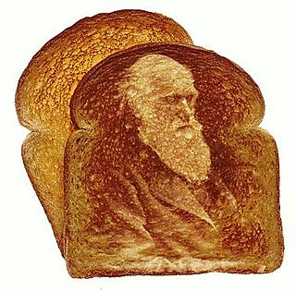
TOAST SONG!!

