Slide 1
ALPHA PHI OMEGA
Spring Semester 2012
Notes:
apo@lists.iwu.edu, link for apo database
<number>

Slide 2
President: Carly Wilson email: apo.oe.president@gmail.com
Welcome Meagan Savage!!!! APO Field Representative
Awards
Nomination Procedure
Nominations March 27 and April 3!
President
VP Community Service
VP Campus, National, Fraternity
VP Membership
VP Pledge Education
VP Fellowship
VP Communications
Sergeant at Arms
Treasurer
VP Leadership?
Fundraising Chair?

Slide 3
President: Carly Wilson email: apo.oe.president@gmail.com
Initiation - April 3, Davidson Room, Business Casual, 9 PM
Last Meeting, Changeover, Senior Recognition - April 17
LEADERSHIP OPPORTUNITY THIS THURSDAY! Executive Board Question and Answer Session - Thursday, April 22 8PM CNS
Come to exec board this Sunday at 9 PM for an additional leadership point!

Slide 4
VP Community: Michelle Moon email: apo.oe.community@gmail.com
Spring Carnival - Saturday, April 14 - Stevenson Elementary School
Children's Home + Aid 5K - Sunday, April 15
Events with Action Research Center, Clarehouse, and The Baby Fold hopefully coming u

Slide 5
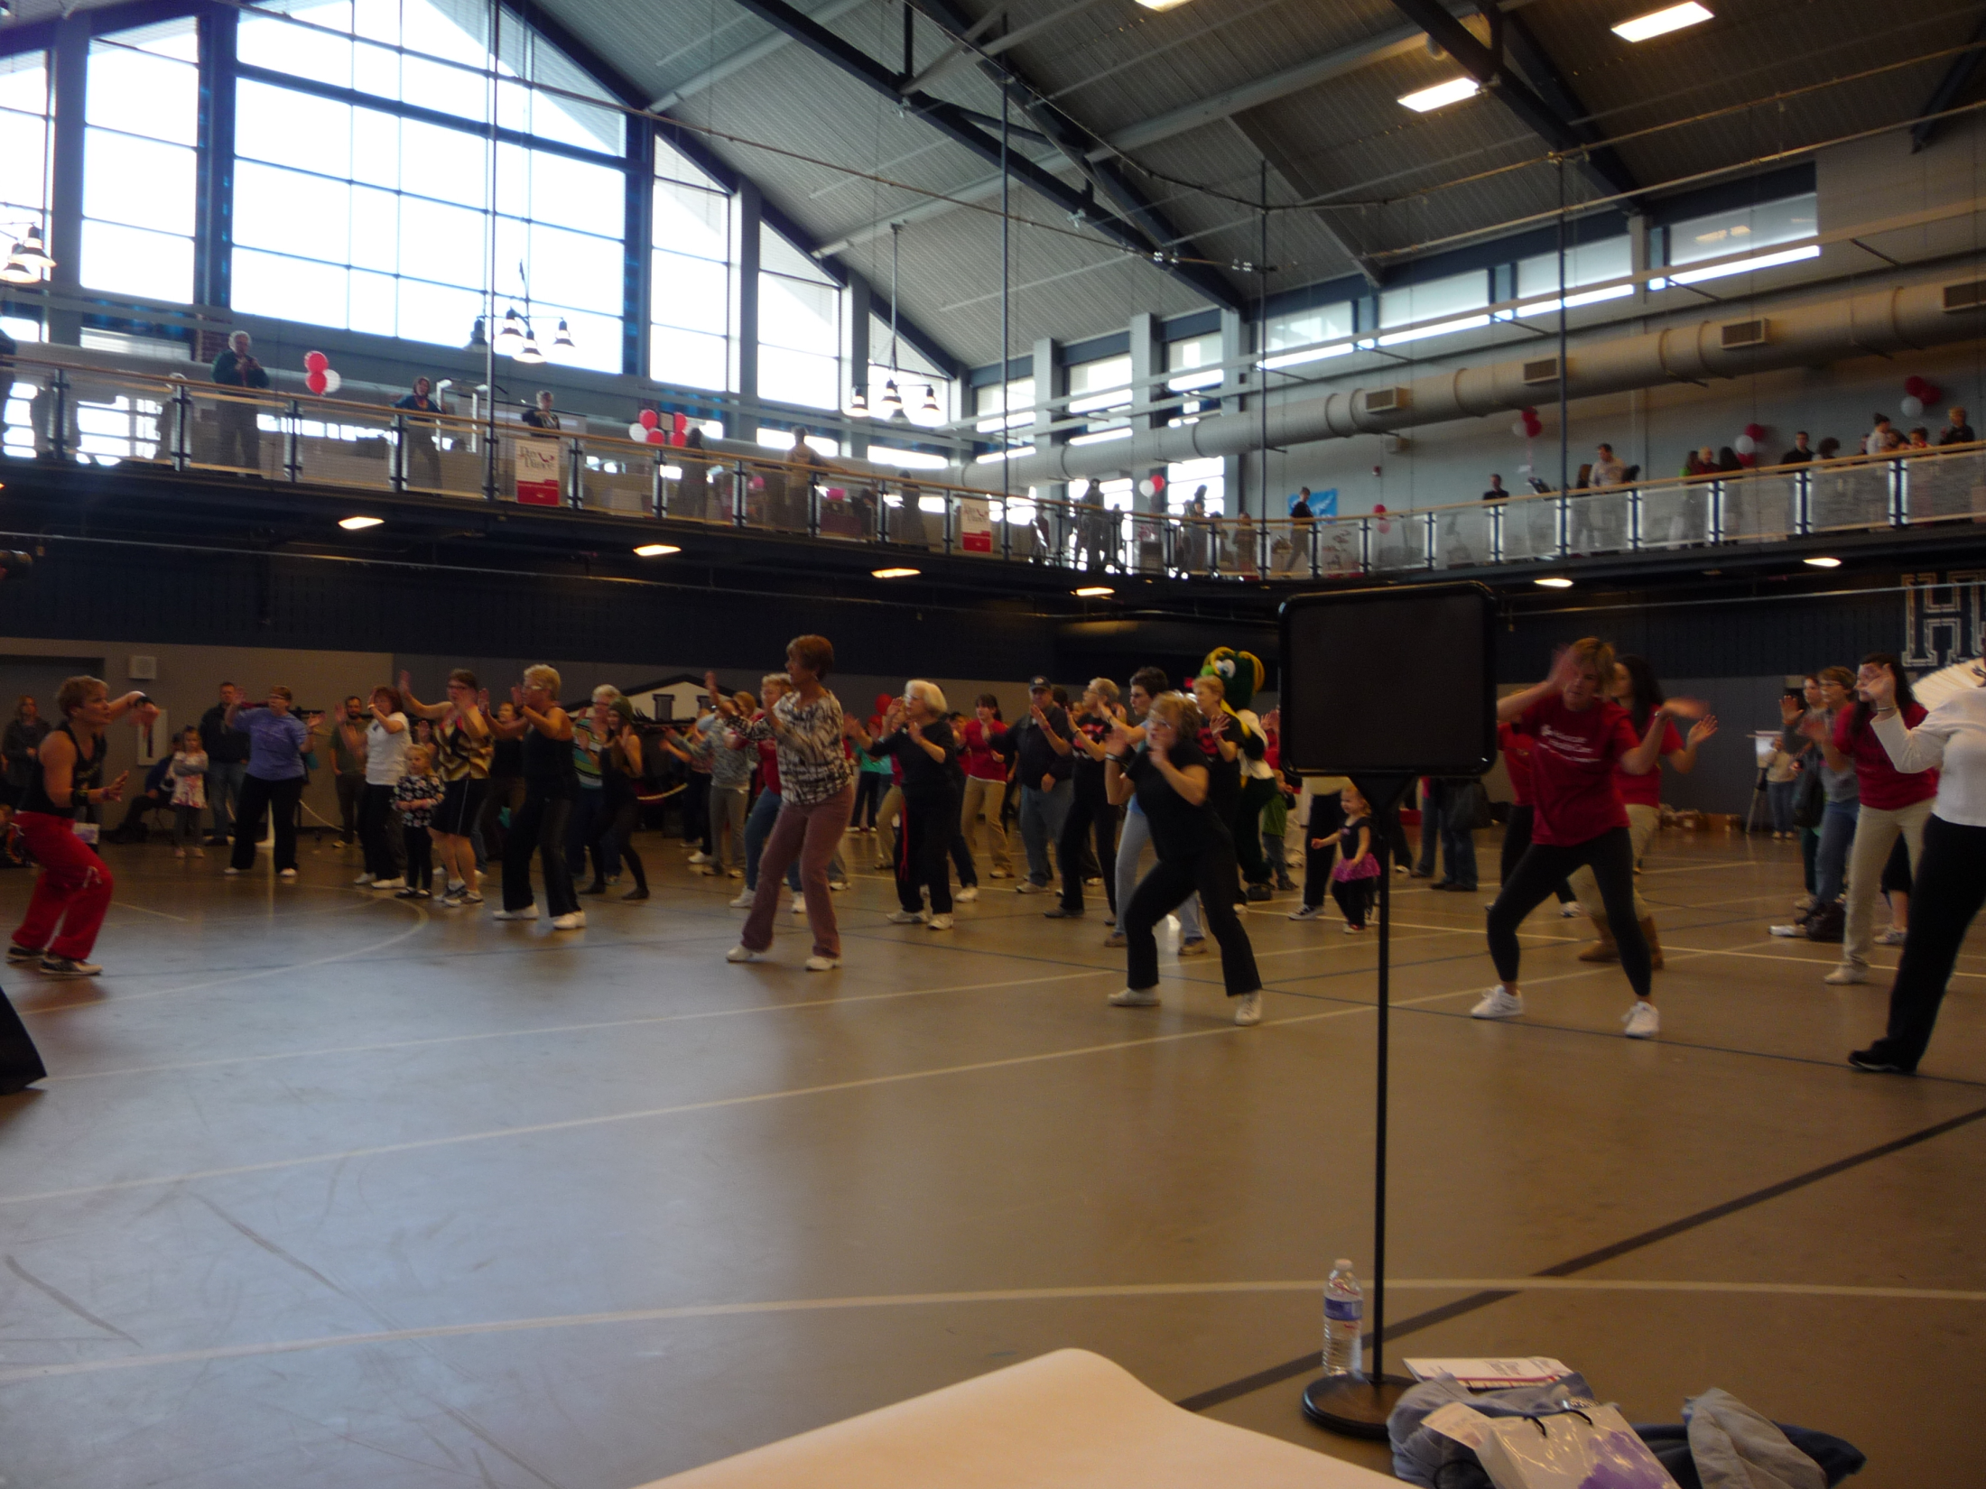
VP Community: Michelle Moon email: apo.oe.community@gmail.com

Slide 6
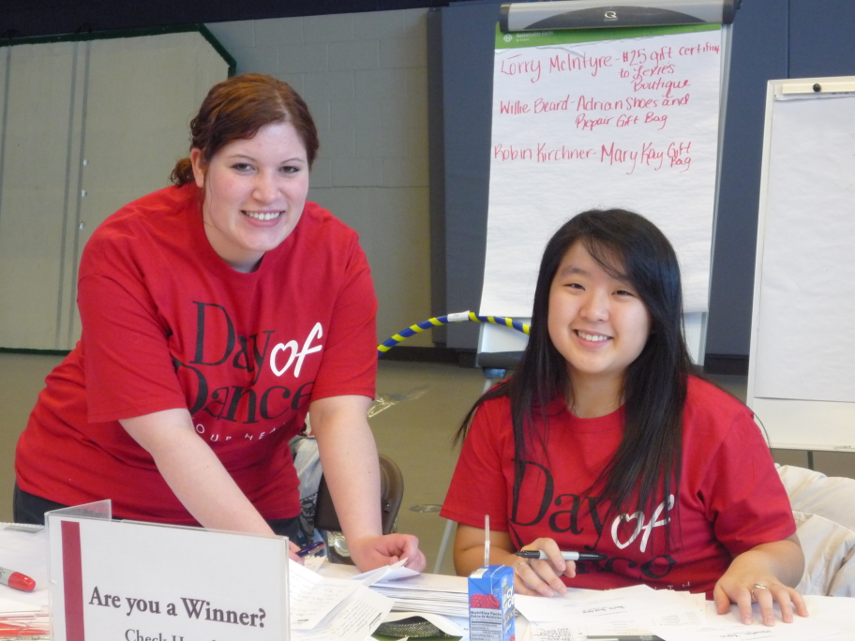

Slide 7
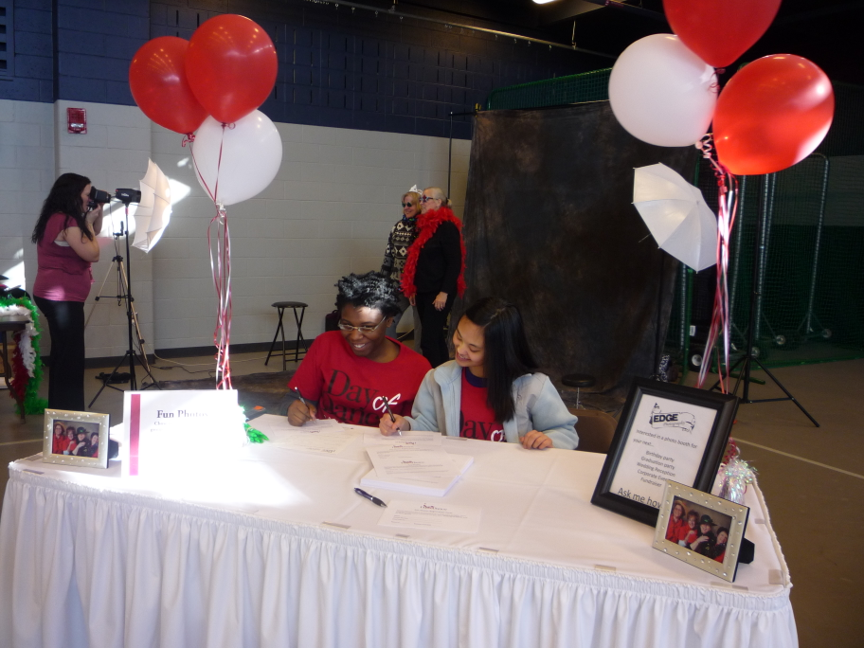

Slide 8
VP Campus, National & Frat.: Ronnie Watson email: apo.oe.cnf@gmail.com
Letters to Soldiers with ISU APO - National
5 pm Stevenson 401
March 21st (tomorrow) and 26th (Monday)
Great chance to meet our brothers!
Homerathon! - Campus
Wednesday-Thursday
1st floor Ames
1pm-7:30am (yes, an all nighter)
2 hour shifts
Sign-up sheet floating around with task description - INCLUDE NAME, NUMBER, EMAIL
Contact name: Melissa Huang (309) 826-2056 mhuang@iwu.edu
Blood Drive – National
Thursday 12-6pm Hansen

Slide 9
VP Campus, National & Frat.: Ronnie Watson email: apo.oe.cnf@gmail.com
Boys and Girls Club Orientation - National
Tuesday, April 3rd
4:30pm
1615 W. Illinois Street Bloomington, IL 61701
MUST HAVE VOLUNTEER FORM AND BACKGROUND CHECK WAIVER FILLED OUT
Quilt Show Set-Up - Campus
Thursday April 12th
8am-12pm - 1 hour shifts
IWU Wellness Expo - Campus
Saturday April 14th
More Events being planned - keep an eye on email and apoonline.org for new events

Slide 10
VP Fellowship: Vicki Simmons email: apo.oe.fellowship@gmail.com
Hooray, Formal is this Saturday!! 7-10 p.m. at Hawthorn Suites (directions on back of tickets) tickets are $10 - I will take money now/tomorrow from 11:15-noon or 4-5 in CNS atrium Upcoming fellowships: Pilates: Wednesday, 3/21 at 7 pm Dinner at FlatTop: Thursday, 3/29 at 6 pm Ice Cream at Coldstone: Thursday, 4/12 at 7:30 pm Undercover XX: Friday, 4/13 at 8 pm

Slide 11
Treasurer: Ben Gesensway email: apo.oe.treasurer@gmail.com
Pizza on the Quad
March 31
11pm - 1 am
Car Wash
April 14
11am - 5pm
Kroger parking lot
2 shifts

Slide 12
Pledge Educator: Liz Kuehn email: apo.oe.pledge@gmail.com
Pledge meetings are held in CNS C102 at 8:15pm on Tuesdays and actives need to come to at least one meeting!!
Pledges keep sending your hours (service, fellowship, and leadership points) to Tim-- tborchar@iwu.edu

Slide 13
VP Membership: Katherine Henning email: apo.oe.membership@gmail.com
Hours sent in spreadsheet. Questions?
Study Abroad care packages
Birthdays: Allison Whitley – March 7th Chelsea Werries – March 8th Ashley Clifford – March 10th Emily Shearer – March 10th Tim Borchardt – March 17th Katelyn Fink –March 20th

Slide 14
Meet Your Brothers
Janette Abbasi
Skipped kindergarten
Can speak English, Arabic and Spanish
Lived in Jordan for 4 years
Kim Cheffer
Favorite food is the Red Velvet Cheesecake from the Cheesecake Factory
Favorite animal is the wombat

Slide 15
Meet Your Brothers
Chelsea Werries
Is double-jointed in her thumbs and can do weird tricks with them
She does not have a favorite color
Kelsey Koterla
Stephen Hawking stole his “Brief History of Time” from her 4th grade paper
Enjoys tennis and badminton

Slide 16
Meet Your Brothers
Rebeca Cruz
Her name only has one ‘c’ in it
Enjoys the movie Mulan
Sarah Bergman
Adores Williams-Sinoma because she loves to bake

Slide 17
Meet Your Brothers
Simeon Pratt
Is a master of Brazilian Jujitsu
Favorite animal is the lynx
Jill Zierden
Is always mistaken as younger than her sister (to whom she is 4 ½ years older)
Likes the movie Spirited Away

Slide 18
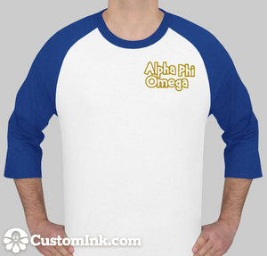
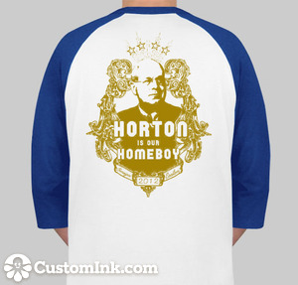
VP Communications: Lindsay Bow email: apo.oe.communications@gmail.com
T-shirts are $17.66 each

Slide 19
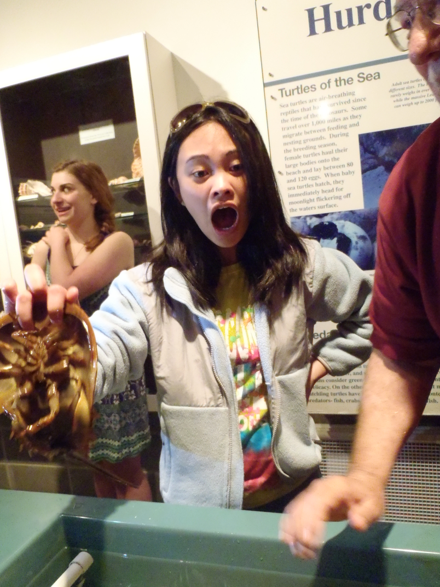
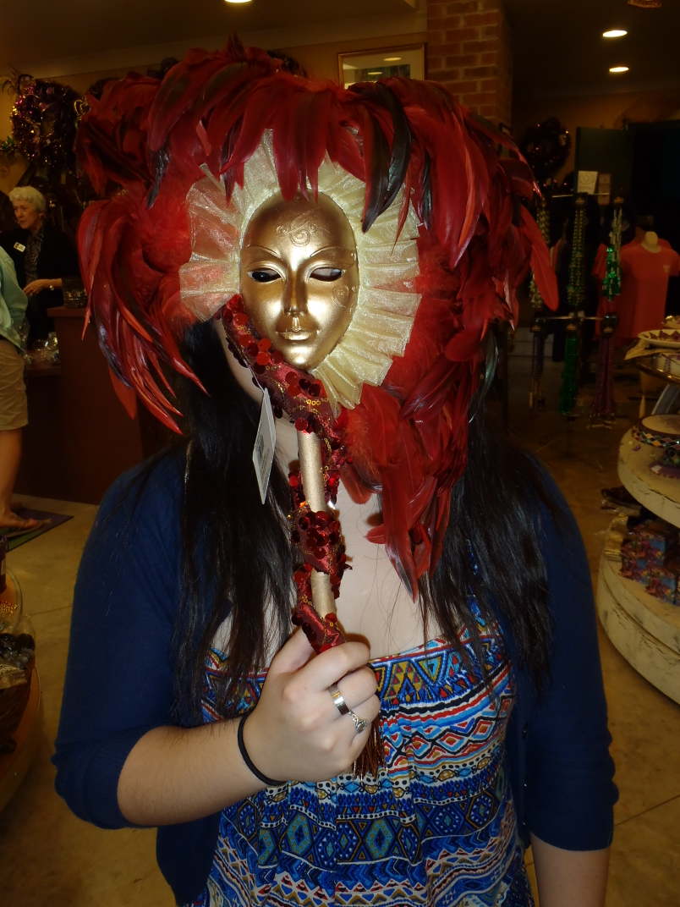
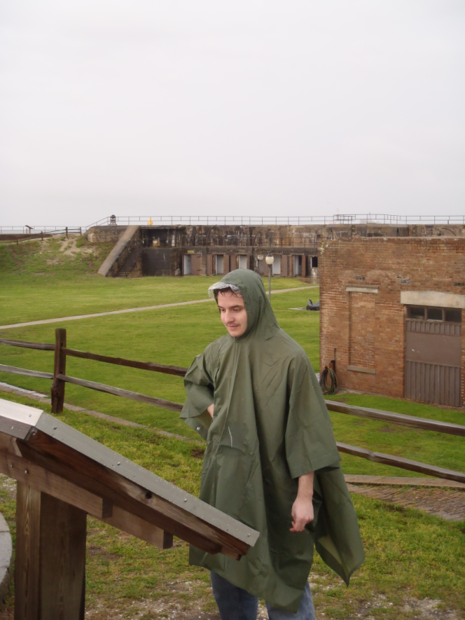
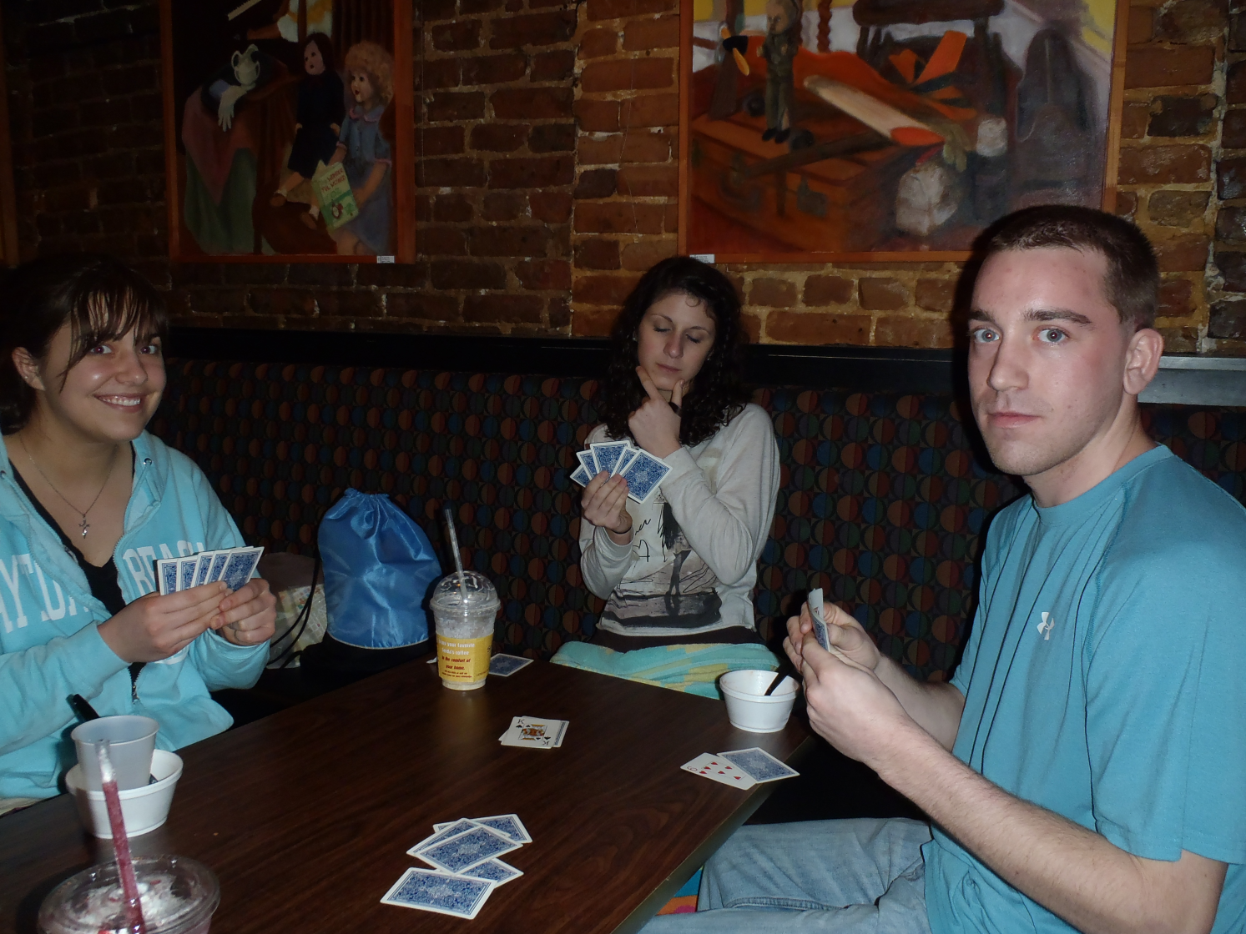
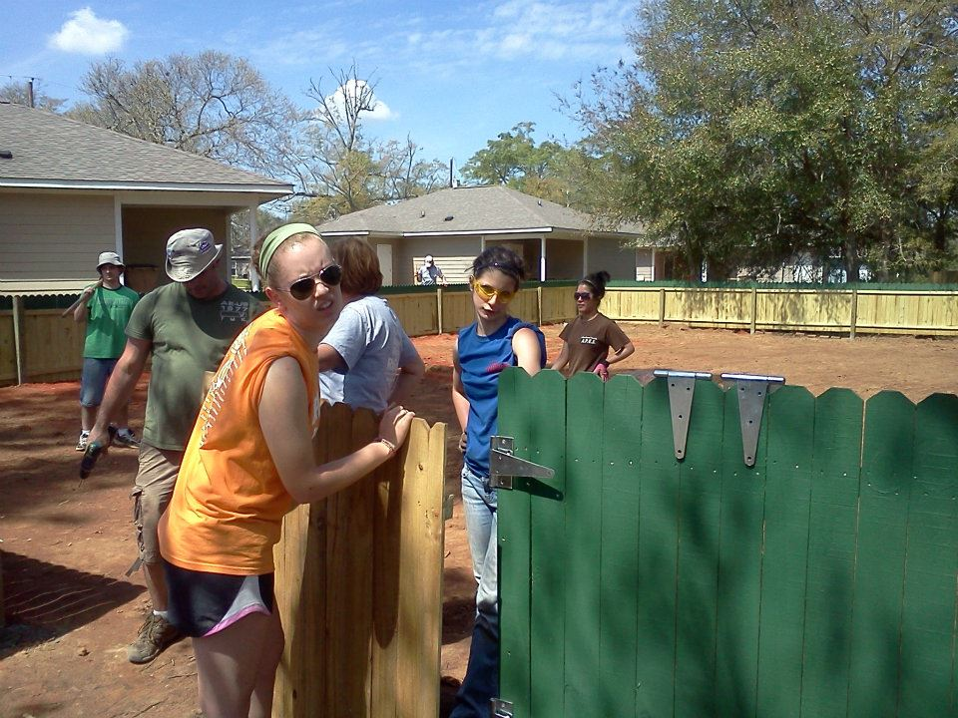
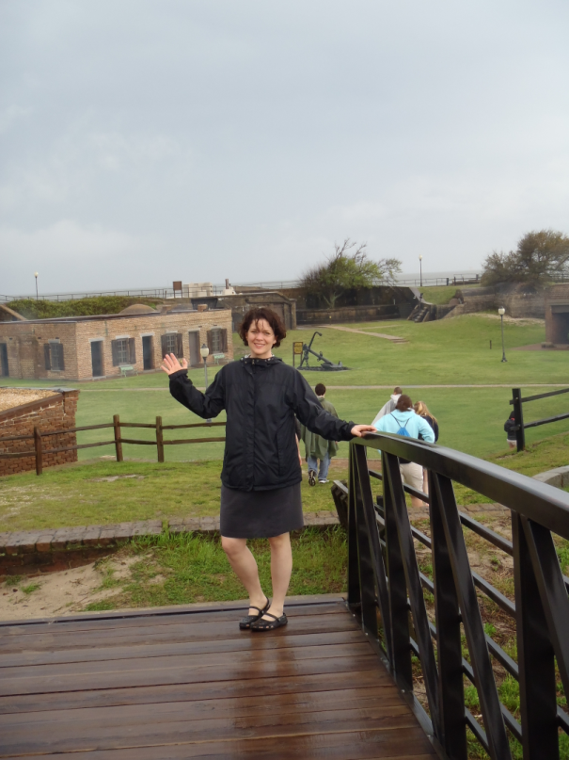
Design #4

Slide 20
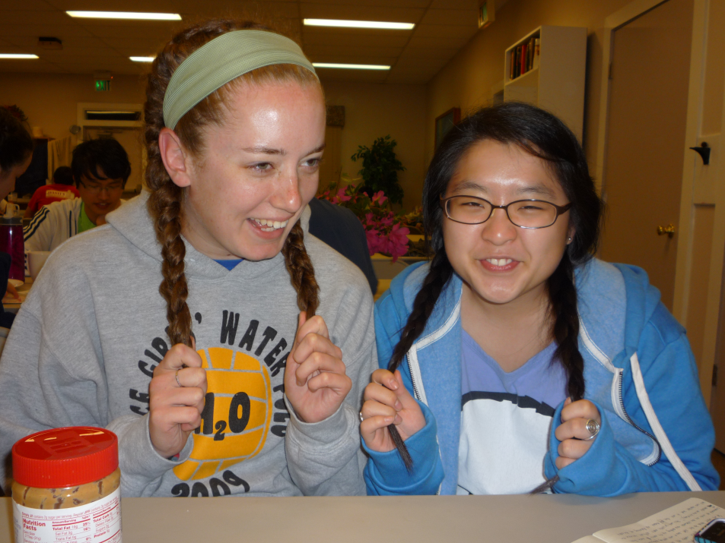
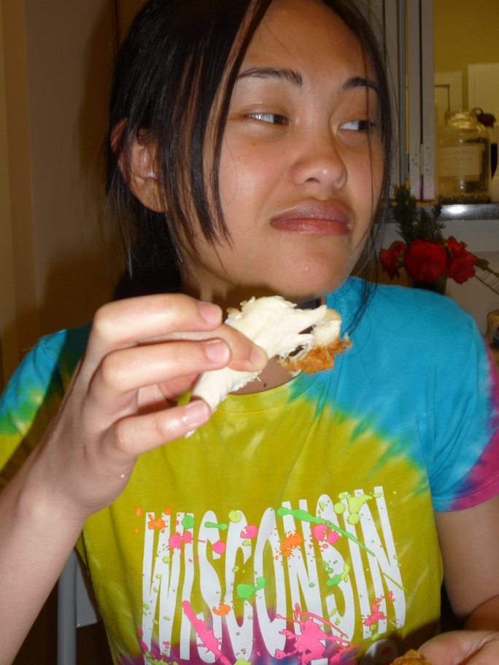
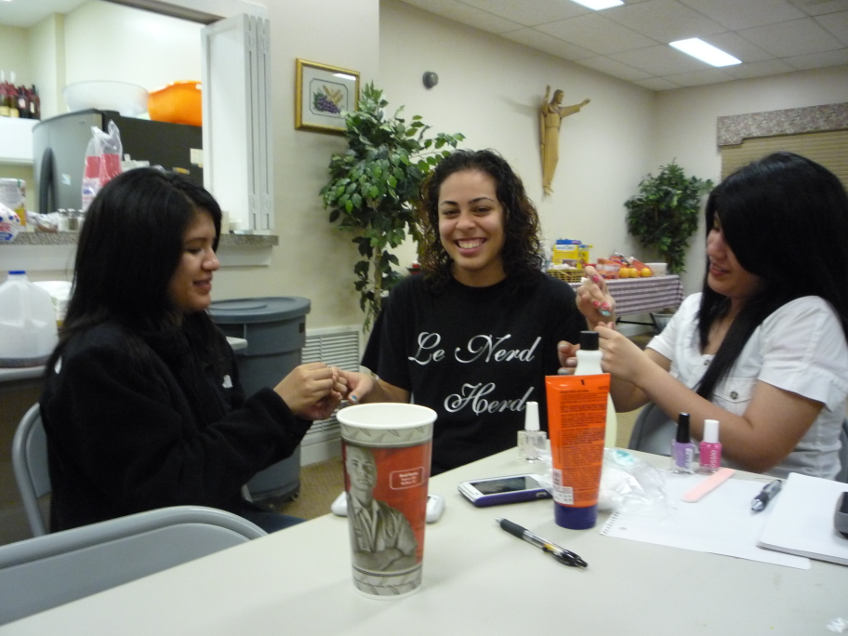

Slide 21
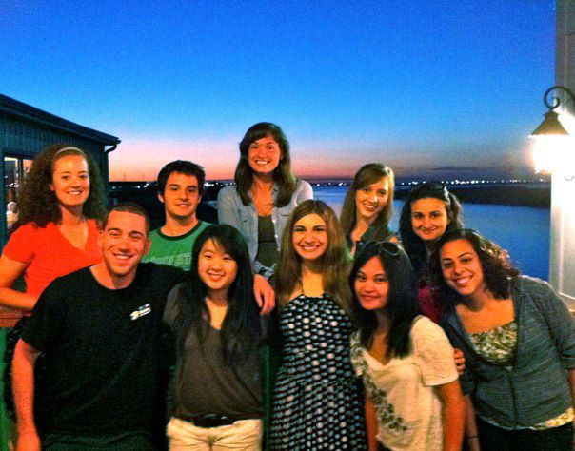

Slide 22
Appointed Positions:
Student Senate Liaison - Sarah Bergman
Chaplain - Daniel Maurer
Historian - Kaitlyn Eichinger
Alumni Chair - Tiara Thomas
Webmaster - Thomas Simmons
Leadership Chair - Hayley Harroun
Section 50 Service Project Chair – Emily Schmidt

Slide 23
Old Business

Slide 24
New Business
Section 6.10: Vice-President of Leadership
The Vice President of Leadership shall:
A. arrange and promote all leadership activities for the active body and shall encourage members to attend
B. appoint an Assistant Leadership Chairman and any other members necessary to assist in their responsibilities as needed -- this committee shall be called the Leadership Committee, within which the Vice President of Leadership shall chair
C. maintain a summary of all leadership activities and contacts
D. present a project proposal for each activity to the Executive Board for any necessary discussion
E. provide or organize at least two (2) leadership activities a month and keep track of the total points made available throughout the semester

Slide 25
New Business
Section 6.11: Fundraising Chair
The Fundraising Chair shall:
A. arrange and promote all fundraising activities for the active body and shall encourage members to attend
B. appoint an Assistant Fundraising Chairman and any other members necessary to assist in their responsibilities as needed – this committee shall be called the Fundraising Committee, within which the Vice President of Fundraising shall chair
C. maintain a summary of all fundraising activities and contacts
D. present a proposal for each activity to the Executive Board for any necessary discussion
E. provide or organize at least (2) fundraising activities a month, raising at least $500 per semester, and keep track of the total hours and funds raised throughout the semester.

Slide 26
New Business
Section 6.9: Treasurer.
The Treasurer shall:
A. collect all dues and fees from chapter members and keep a record thereof;
B. transmit all fees and any accompanying necessary forms to the national office;
C. promptly pay all authorized bills incurred by the chapter and promptly make all other authorized payments;
D. work in accordance with the regulations of Illinois Wesleyan University;
E. be responsible for a report at every business meeting of the active body on the financial condition of the chapter; be responsible for a monthly financial report to the active body on the condition of the chapter
F. apply for nonprofit organization status with the Internal Revenue Service at the beginning of each calendar year;
G. chair the Fundraising Committee, and organize enough projects to profit $300.00 per semester.
G. request appropriate Student Senate funding each spring for the following school year

Slide 27
News or Announcements

Slide 28
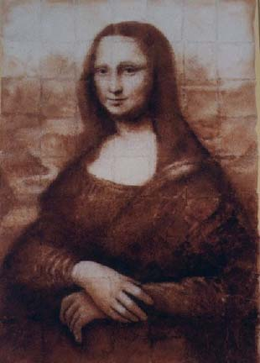
TOAST SONG!!

