Slide 1
ALPHA PHI OMEGA
SPRIng Semester 2012
Notes:
apo@lists.iwu.edu, link for apo database

Slide 2
President: Carly Wilson email: apo.oe.president@gmail.com
Thank you for everyone who attended CAPS
* Summary and future goals will be available after Spring Break
What hours do you still need? Don't panic!
Dates to Remember:
Meagan Savage - APO Field Representative - March 20-22
Nominations - March 27 and April 3
Initiation - April 3
Elections - April 10
Last meeting, Changeover, Senior Recognition - April 17

Slide 3
President: Carly Wilson email: apo.oe.president@gmail.com
Leadership Opportunities
Webinars:
Thurs, Mar 8: How to use the Chapter Assessment and Planning Session (CAPS) Mon, Mar 26: Retention Wed, Apr 11: Officer Transition Mon Apr 16: Graduating Members
Executive Board Meetings: 1 Point
Sundays, 9 PM, CNS Atrium
*Please email me if you want to come!
Ask Exec Board Panel: Time and location TBD! 1 point

Slide 4
President: Carly Wilson email: apo.oe.president@gmail.com
Make your nominations for DSC and DSK NOW!
*Last day to send in your nominations is THIS FRIDAY (March 9)!
Distinguished Service Certificate
- Given to any brother or advisor who is in good standing, and has exemplified exceptional service to the chapter, community, campus, or nation
- Must have pledged Spring 2011 or before
- Maximum of 10 recipients
- Must be approved by 1/2 of the chapter
Distinguished Service Key
- Very prestigious award given to any senior member or advisor of the Omega Epsilon Chapter who is in good standing and has gone above and beyond the normal
requirements of service to the chapter, and exemplifies the three Cardinal Principles to the highest degree.
- One recipient each semester
- Must be approved by 4/5 of the chapter

Slide 5
VP Community: Michelle Moon email: apo.oe.community@gmail.com
Humane Society - Thurs., March 8th 3-5pm
Here's the link again: http://doodle.com/5aeytzmc5dw36kmk
Humane Society Orientations
14th Annual Women's Health Night - Tues, March 20
Set up: 11am-1pm, 1pm-3pm
Passing out pamphlets/evaluation forms: 3pm-5:30pm, 5:30pm-8pm

Slide 6
VP Campus, National & Frat.: Ronnie Watson email: apo.oe.cnf@gmail.com
Habitat Build
Habitat Restore
Boys and Girls Club?
Quilt Show: April 12th
Wellness Expo: April 14th
MORE SOON!

Slide 7
VP Fellowship: Vicki Simmons email: apo.oe.fellowship@gmail.com
Chapel Hour: Tomorrow at 11 (meet in chapel lobby a little before) - Sign up!!
Bowling: Wednesday, 3/7 at 9 pm
Dinner at BWW: Tuesday 3/20 at 6 pm
Pilates: Wednesday 3/21 at 7 pm
Formal: Saturday 3/24 at 7 pm - Please sign up on APOonline if you are thinking about going!
Dinner at FlatTop: Thursday 3/29 at 6 pm
Ice cream at ColdStone: Thursday 4/12 at 7:30 pm
Undercover XX: Friday 4/13 at 8 pm

Slide 8
Treasurer: Ben Gesensway email: apo.oe.treasurer@gmail.com
Pizza on the Quad
March 30th 11 pm - 1 am March 31st
Making dolls

Slide 9
Pledge Educator: Liz Kuehn email: apo.oe.pledge@gmail.com
Pledge meetings are held in CNS C102 at 8:15pm on Tuesdays and actives need to come to at least one meeting!!
Pledges keep sending your hours (service, fellowship, and leadership points) to Tim-- tborchar@iwu.edu

Slide 10
Meet Your Pledges
Joanna Wierzbicki
Likes anime
Favorite shows and movies are Supernatural, Eurotrip, and Inception
Favorite animal is a fox
Zeeni Zaheer
Occasionally she has a Minnesotan accent
She went to the Dominican Republic and distributed food and helped build a home
Favorite animal is a hippogriff

Slide 11
Meet Your Pledges
Katelyn Ahmann
She decorates cakes and works at a movie theater
Favorite snacks are popcorn and fresh baked cookies
Happy Birthday!!

Slide 12
VP Membership: Katherine Henning email: apo.oe.membership@gmail.com
Send me ALL your hours over spring break (toward the beginning)
I will be sending out a spreadsheet with my totals at the end of spring break
Birthdays: Jill Zierden – March 1st

Slide 13
Meet Your Brothers
Alyssa Baker
She can nap anywhere
One of her favorite movies is the Sandlot
Emily Shearer
Wants to study abroad next semester
Her favorite animal is the giraffe

Slide 14
Meet Your Brothers
Claudia Petcu
Is a psychology major
Her favorite color is pink
Lauren Cowles
Spent last semester teaching high school juniors
Enjoys the T.V. shows Gossip Girls and Grey’s Anatomy

Slide 15
Meet Your Brothers
Ronnie Watson
Is a soviet spy
Favorite activities include sleeping and spying
Emily Schmidt
Loves scarves, tea, and horses
Is going to teach abroad!

Slide 16
VP Communications: Lindsay Bow email: apo.oe.communications@gmail.com
Timeline for t-shirts:
This week: vote on design, sign-up for shirt
Will have quote by the end of the week
March 19-27: Turn in money for shirts
March 28: I will order shirts
Designs for Baseball shirts…

Slide 17
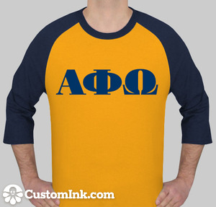
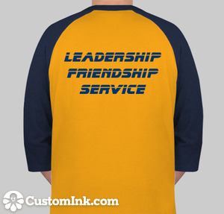
Design #1

Slide 18
Design #2

Slide 19
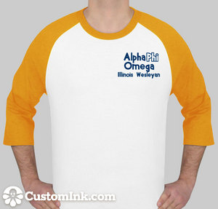
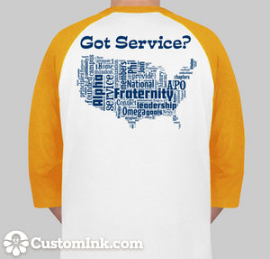
Design #3

Slide 20
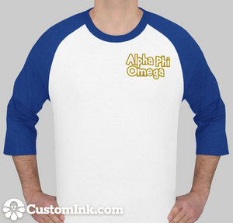
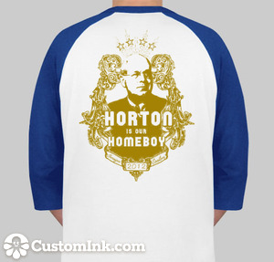
Design #4

Slide 21
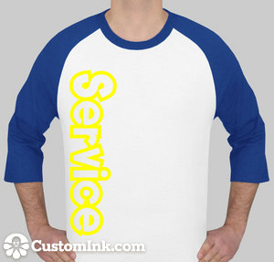
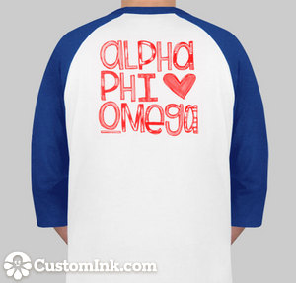
Design #5

Slide 22
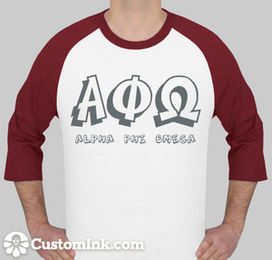
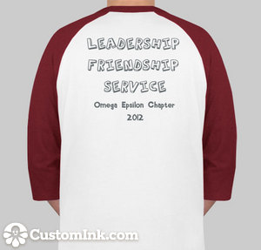
Design #6

Slide 23
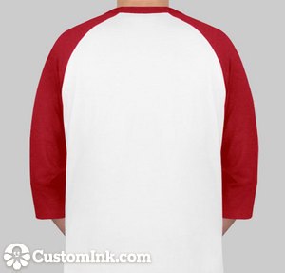
Design #7

Slide 24
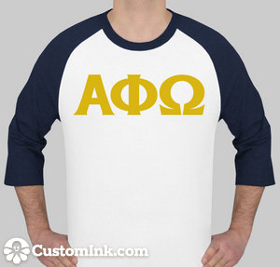
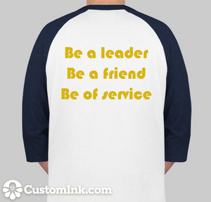
Design #8

Slide 25
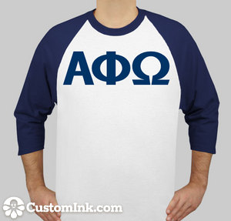
Design #9

Slide 26
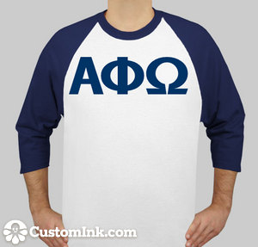
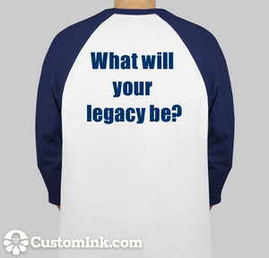
Design #10

Slide 27
Appointed Positions:
Student Senate Liaison - Sarah Bergman
Chaplain - Daniel Maurer
Historian - Kaitlyn Eichinger
Alumni Chair - Tiara Thomas
Webmaster - Thomas Simmons
Leadership Chair - Hayley Harroun
Section 50 Service Project Chair – Emily Schmidt

Slide 28
Old Business

Slide 29
New Business
Section 6.10: Vice-President of Leadership
The Vice President of Leadership shall:
A. arrange and promote all leadership activities for the active body and shall encourage members to attend
B. appoint an Assistant Leadership Chairman and any other members necessary to assist in their responsibilities as needed -- this committee shall be called the Leadership Committee, within which the Vice President of Leadership shall chair
C. maintain a summary of all leadership activities and contacts
D. present a project proposal for each activity to the Executive Board for any necessary discussion
E. provide or organize at least two (2) leadership activities a month and keep track of the total points made available throughout the semester

Slide 30
New Business
Section 6.11: Vice President of Fundraising
The Vice President of Fundraising shall:
A. arrange and promote all fundraising activities for the active body and shall encourage members to attend
B. appoint an Assistant Fundraising Chairman and any other members necessary to assist in their responsibilities as needed – this committee shall be called the Fundraising Committee, within which the Vice President of Fundraising shall chair
C. maintain a summary of all fundraising activities and contacts
D. present a proposal for each activity to the Executive Board for any necessary discussion
E. provide or organize at least (2) fundraising activities a month, profiting at least $300 per semester, and keep track of the total hours and profits made throughout the semester.

Slide 31
New Business
Section 6.9: Treasurer.
The Treasurer shall:
A. collect all dues and fees from chapter members and keep a record thereof;
B. transmit all fees and any accompanying necessary forms to the national office;
C. promptly pay all authorized bills incurred by the chapter and promptly make all other authorized payments;
D. work in accordance with the regulations of Illinois Wesleyan University;
E. be responsible for a report at every business meeting of the active body on the financial condition of the chapter; be responsible for a monthly financial report to the active body on the condition of the chapter
F. apply for nonprofit organization status with the Internal Revenue Service at the beginning of each calendar year;
G. chair the Fundraising Committee, and organize enough projects to profit $300.00 per semester.
H. request appropriate Student Senate funding each spring for the following school year

Slide 32
News or Announcements

Slide 33
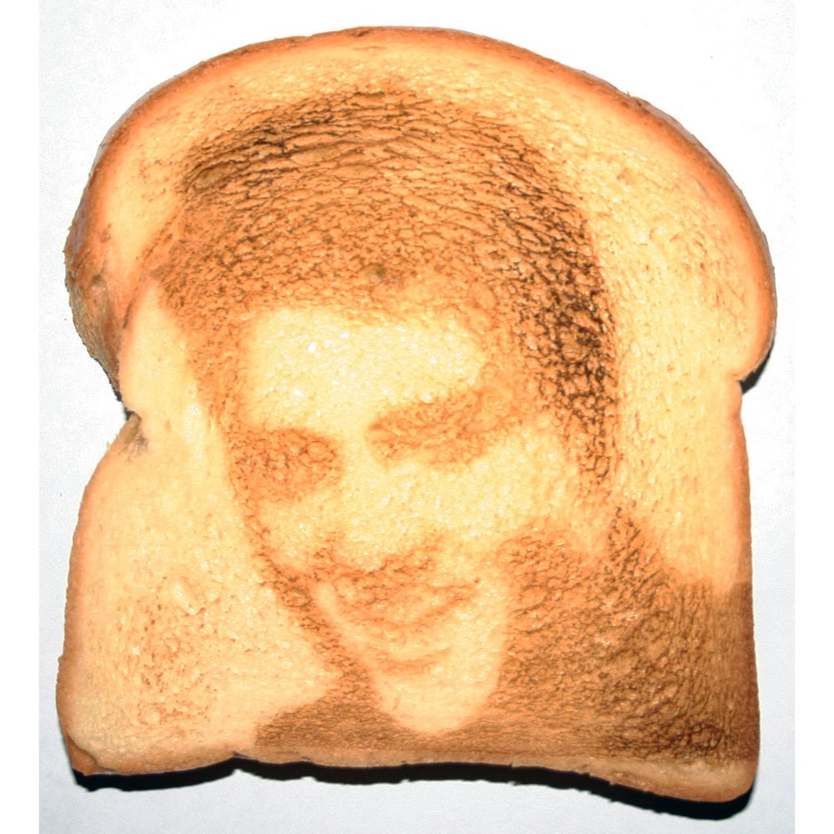
TOAST SONG!!

