Slide 1
Alpha Phi Omega
Fall 2012
September 11, 2012

Slide 2
General Announcements
Brothers going associate
Brittany Dunleavy

Slide 3
Dates to Remember
Fall APO LEADS Day at Illinois State University - September 29
Last day to turn in Dues - October 2 ($40)
Fall Section Service Project at University of Illinois at Urbana-Champaign - October 20
Pledge Ceremony - September 18
Fall Section 50 Conference at Parkland College - November 2-3
National Service Week - November 4-10
Initiation - November 13
Last Meeting - December 4

Slide 4
Appointed Positions
Alumni Chair
Chaplain
Historian
Student Senate Liaison
National Service Week Chair
Webmaster
*All appointed positions will receive 3 leadership points upon the completion of their work. (At the discretion of the executive board)

Slide 5
Service Events
Marcfirst Carwash at Ace Hardware: 09/23
Majors and Minors Fair in the Young Main Lounge: 09/26
Peace Garden Session: 09/30
Easter Seals Run the Woods at Lake Bloomington: 10/06
We Care Twin Cities Marathon: 09/28
Haunted Trail Volunteer Orientation: 10/17
Haunted Trail Event: 10/19, 10/20, 10/26 and 10/27

Slide 6
Pledge
If you are still interested in being a pledge parent, talk to me or email me.You will find out if you have a pledge kid and who it is by this Saturday. Pledge parent reveal will be at the pledge ceremony.
All actives must attend at least 1 pledge meeting. Meetings are Sundays at 8pm in C102.

Slide 7
Leadership
LEADS Day: 09/29
Greeters at Pledge Meetings: 09/16
Graduate School Preparation: Navigating the maze: 09/12
Interviewing Success: 09/12
Taking the Road Less Traveled: 09/12
Event Coordinator feedback sheets on Facebook. Send to apo.oe.eventcoordinator@gmail,com.

Slide 8
Membership
You do NOT have to email hours to me anymore!
Exceptions: keep sending personal and fellowship
Using Event Coordinator and APO Online now
Birthdays
9/6: Michelle Brand
9/7: Daniel Maurer
9/10: Carissa Ball
9/14: Lauren Burke

Slide 9
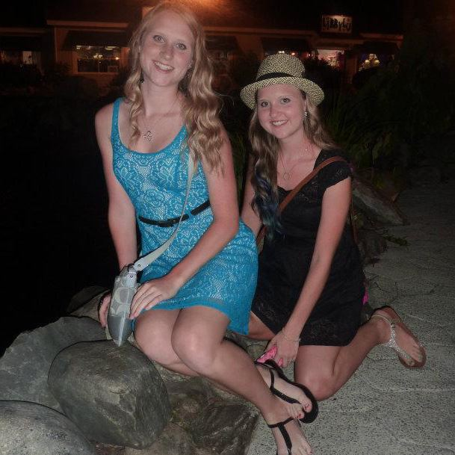
Brothers of the Week
Carissa Ball
Sophomore Psychology Major
She likes the Backstreet Boys and Titanic
Her favorite animal is a puppy
Fun fact: She is a twin

Slide 10
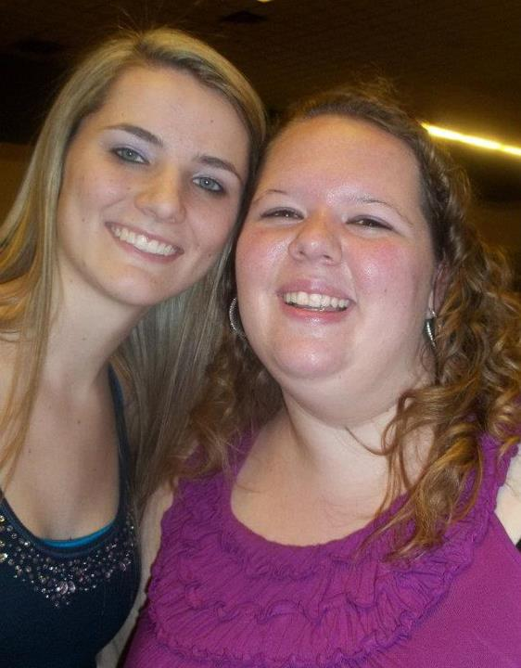
Brothers of the Week
Michelle Brand
Junior Psychology Major
Her favorite book is The Hunger Games
She likes Grey’s Anatomy
Fun fact: Her 6th great grandfather wrote “Silent Night”

Slide 11
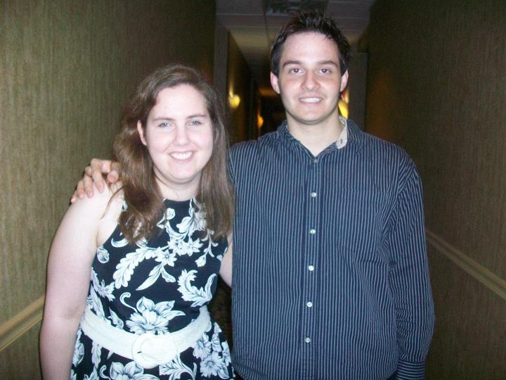
Brothers of the Week
Daniel Maurer
Senior Psychology Major
He likes the book, To Kill a Mockingbird
He enjoys The Beatles and Forrest Gump
Fun fact: He wants to do social work in China post-IWU

Slide 12
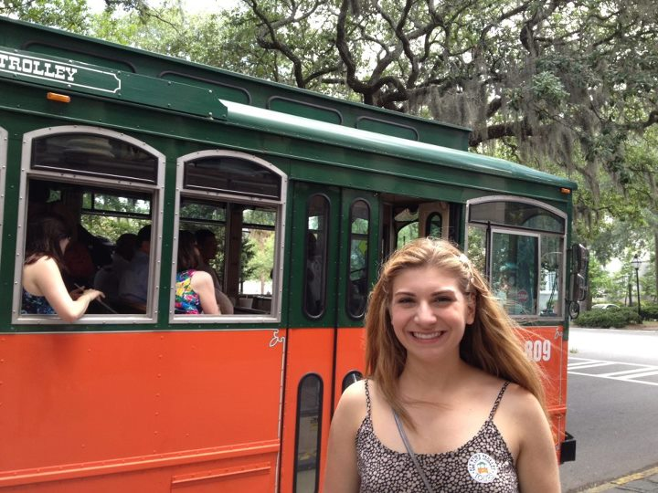
Brothers of the Week
Lauren Burke
Junior Political Science Major
Her favorite TV show is How I Met Your Mother
She likes tigers
Fun fact: She’s writing/trying to publish a book

Slide 13
Chapter for the next 2 weeks (09/18 and 09/25) will be in the Joslin Atrium!

Slide 14
News, Announcements, Props
President’s convocation w/ rebecca skloot: Tomorrow 11am- westbrook auditorium
Fun, run, Walk and roll: Sat.- Hansen
Iwu/isu internship fair: tues.- isu bone student center

Slide 15
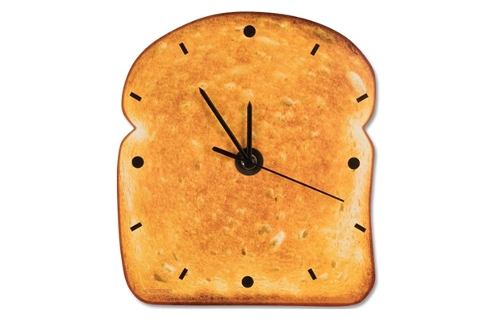
Time for the Toast Song!

